Slide 1
Spatial and temporal data management

Slide 2
Chapter Summary
Model spatial data
Create database elements to capture this type of data
Model temporal data
Create database elements to capture this type of data

Slide 3
Data management developments
Location-based services
Time-varying data

Slide 4
MySQL spatial extensions
Follow the specifications of the Open Geospatial Consortium
Implements a subset of the proposed extensions

Slide 5
Spatial data
Managing spatially-referenced data
Geographic information systems (GIS)
Theme
The spatial counterpart of an entity
River, road, scenic lookout
Map
A set of themes represented on paper or a screen
Geographic object
An instance of a theme

Slide 6
Generic spatial data types
Data type | Dimensions | Example
Point | 0 | Scenic lookout
Line | 1 | River
Region | 2 | County

Slide 7
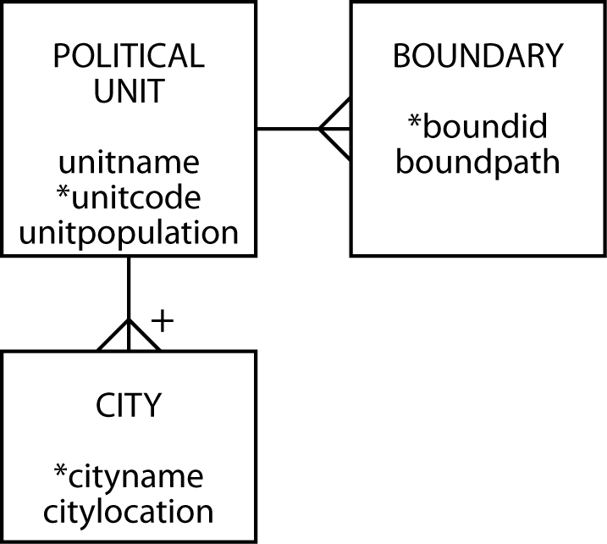
Data model for political units

Slide 8
MySQL geometric data types
Type | Representation | Description
Point | POINT(x y) | A point in space (e.g., a city)
LineString | LINESTRING(x1 y1,x2 y2,…) | A sequence of points with linear interpolation between points (e.g., a road)
Polygon | POLYGON((x1 y1,x2 y2,…), (x1 y1,x2 y2,…)) | A polygon (e.g., a boundary), which has a single exterior boundary and zero or more interior boundaries ( i.e., holes)

Slide 9
Create tables
CREATE TABLE political_unit (
unitname VARCHAR(30) NOT NULL,
unitcode CHAR(2),
unitpop DECIMAL(6,2),
PRIMARY KEY(unitcode));
CREATE TABLE boundary (
boundid INTEGER,
boundpath POLYGON NOT NULL,
unitcode CHAR(2),
PRIMARY KEY(boundid),
CONSTRAINT fk_boundary_polunit FOREIGN KEY(unitcode)
REFERENCES political_unit(unitcode));
CREATE TABLE city (
cityname VARCHAR(30),
cityloc POINT NOT NULL,
unitcode CHAR(2),
PRIMARY KEY(unitcode,cityname),
CONSTRAINT fk_city_polunit FOREIGN KEY(unitcode)
REFERENCES political_unit(unitcode));

Slide 11
Insert rows
INSERT INTO political_unit VALUES ('Republic of Ireland','ie', 3.9);
INSERT INTO political_unit VALUES ('Northern Ireland','ni', 1.7);
INSERT INTO boundary VALUES
(1,GeomFromText('polygon((9 8, 9 3, 4 1, 2 2, 1 3, 3 5, 3 6, 2 6,
2 9, 5 9, 5 10, 6 11, 7 11, 7 10, 6 9, 7 8, 7 9, 8 9, 8 8, 9 8))'),'ie');
INSERT INTO boundary VALUES
(2,GeomFromText('polygon((7 11, 9 11, 10 9, 10 8, 8 8, 8 9, 7 9,
7 8, 6 9, 7 10, 7 11))'),'ni');
INSERT INTO city VALUES ('Dublin',GeomFromText('POINT(9 6)'),'ie');
INSERT INTO city VALUES ('Cork',GeomFromText('POINT(5 2)'),'ie');
INSERT INTO city VALUES ('Limerick',GeomFromText('POINT(4 4)'),'ie');
INSERT INTO city VALUES ('Galway',GeomFromText('POINT(4 6)'),'ie');
INSERT INTO city VALUES ('Sligo',GeomFromText('POINT(5 8)'),'ie');
INSERT INTO city VALUES ('Tipperary',GeomFromText('POINT(5 3)'),'ie');
INSERT INTO city VALUES ('Belfast',GeomFromText('POINT(9 9)'),'ni');
INSERT INTO city VALUES ('Londonderry',GeomFromText('POINT(7 10)'),'ni');

Slide 12
Some familiar functions
Function | Description
AVG(INT, DECIMAL)
REGEXP(CHAR)
LIKE(CHAR)
REPLACE(CHAR)

Slide 13
Some MySQL geometry functions
Function | Description
X(Point) | The x-coordinate of a point
Y(Point) | The y-coordinate of a point
GLength(LineString) | The length of a linestring
NumPoints(LineString) | The number of points in a linestring
Area(Polygon) | The area of a polygon

Slide 14
Area
What is the area of the Republic of Ireland?
SELECT AREA(boundpath)*1406
as "Area (km^2)" from political_unit, boundary
WHERE unitname = 'Republic of Ireland'
AND political_unit.unitcode = boundary.unitcode;
Area(km^2)
71706
One unit on the map is 37.5 km so the area of one grid unit is 1406 km²

Slide 15
Class Exercise 1
What is the area of Northern Ireland in square kilometers?
How close is the computed value to that reported in Wikipedia?

Slide 16
Distance
How far, as the crow flies, is it from Sligo to Dublin?
SELECT GLength(LineString(orig.cityloc,dest.cityloc))*37.5
AS "Distance (kms)"
FROM city orig, city dest
WHERE orig.cityname = 'Sligo'
AND dest.cityname = 'Dublin';
Distance (kms)
167.71

Slide 17
Closest
What is the closest city to Limerick?
SELECT dest.cityname FROM city orig, city dest
WHERE orig.cityname = 'Limerick'
AND GLength(LineString(orig.cityloc,dest.cityloc))=
(SELECT MIN(GLength(LineString(orig.cityloc,dest.cityloc))) FROM city orig, city dest
WHERE orig.cityname = 'Limerick' AND dest.cityname <> 'Limerick');
DISTANCE function will be implemented in MySQL at some point and will simplify the expression
cityname
Tipperary

Slide 18
Westernmost
What is the westernmost city in Ireland?
SELECT west.cityname FROM city west
WHERE NOT EXISTS
(SELECT * FROM city other WHERE X(other.cityloc) < X(west.cityloc));
Pick the first city from City (call it West). (OUTER QUERY)
Find any city in City table where the X coordinate is less than the X coordinate of the city West. (INNER QUERY).
If there is one such city, then drop West from the query result (NOT EXISTS)
cityname
Limerick
Galway

Slide 19
Class Exercise 2
What is the eastern most city in Northern Ireland?
What is the area of Northern Ireland? Because Northern Ireland is part of the United Kingdom and miles are still often used to measure distances, report the area in square miles.
What is the direct distance from Belfast to Londonderry in miles?
What is the northernmost city of the Republic of Ireland?

Slide 20
Geometry collections
A geometry collection is a collection of one more other geometries
Recent addition to MySQL

Slide 21
MultiPoint
A collection of points
Bus stops on a campus
Data type is MULTIPOINT
MULTIPOINT(9.0 6.1, 8.9, 6.0)

Slide 22
MultiLineString
A collection of line strings
Bus routes on a campus
Data type is MULTILINESTRING
MULTILINESTRING((9 6, 4 6), (9 6, 5 2))

Slide 23
MultiPolygon
A collection of polygons
Buildings on a campus
Data type is MULTIPOLYGON
MULTIPOLYGON(((0 0,10 0,10 10,0 10,0 0)),((5 5,7 5,7 7,5 7, 5 5)))

Slide 24
GeometryCollection
A collection of geometries
Bus route and its bus stops
Data type is GEOMETRYCOLLECTION
GEOMETRYCOLLECTION(LINESTRING(15 15, 20 20), POINT(10 10), POINT(30 30))

Slide 25
Inserting data
Use GeomFromText
INSERT INTO table VALUES GeomCollFromText('GEOMETRYCOLLECTION(POINT(1 1),LINESTRING(0 0,1 1,2 2,3 3,4 4))');

Slide 26
Class Exercise 3
Modify the example geometry database design to include:
Historic buildings in a city
Walking paths in a city
Use of the MULTIPOLYGON data type to indicate a political region’s boundary
Add hypothetical data by referring to 3 historic buildings in any one city.

Slide 27
R-tree
Used to store n-dimensional data (n>=2)
Minimum bounding rectangle concept
A
D
C
B
E
X
Y
X
Y
I
n
d
e
x
s
e
t
A
B
C
D
E
S
e
q
u
e
n
c
e
s
e
t

Slide 28
R-tree searching
Search for the object covered by the shaded region
A
D
C
B
E
X
Y

Slide 29
Temporal data
Data have an associated time
When valid
When stored
Different database states recorded
Larger databases

Slide 30
Times
Transaction time
Timestamp applied when data are entered
Valid time
Time when value is valid or true

Slide 31
Times

Slide 32
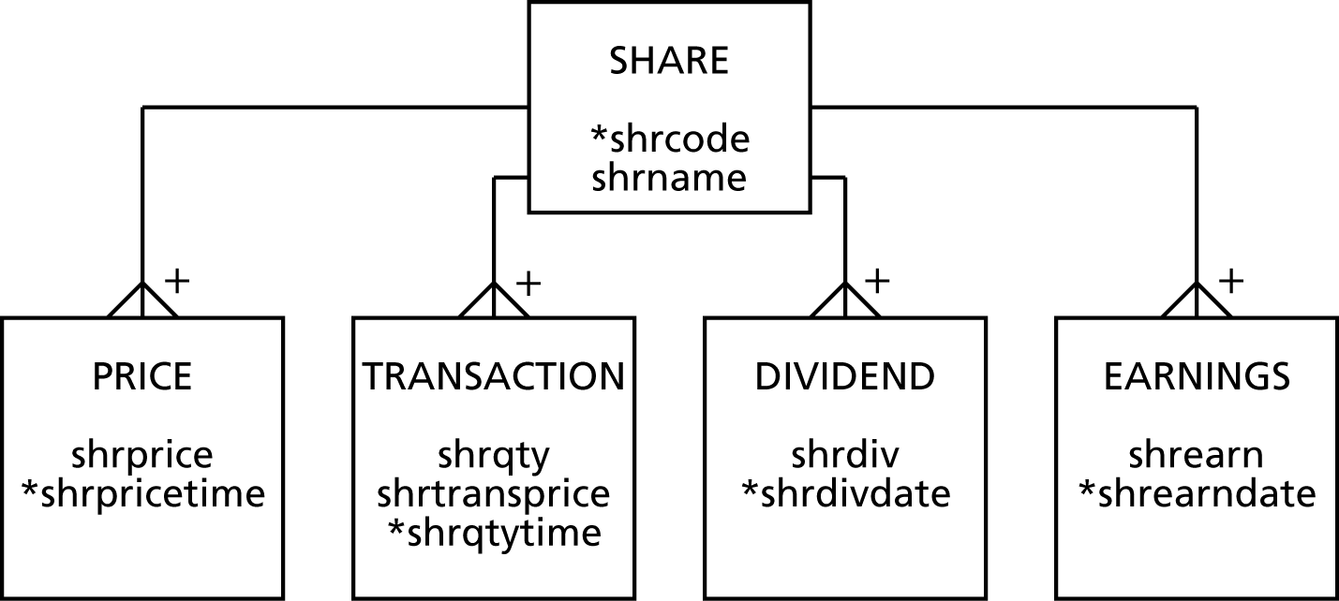
Modeling temporal data

Slide 33
TSQL
Need additional features for
Data definition
Constraint specification
Data manipulation
Querying
TSQL (temporal structured query language) is designed to provide these features

Slide 34
Conclusions
The need to maintain spatial data will increase as location-based services become more common
Temporal data management will become more common so companies and customers have a complete historical record
New data types creates a need for new functions

Slide 35
Chapter Summary
Model spatial data
Create database elements to capture this type of data
Model temporal data
Create database elements to capture this type of data

Slide 36
Next Week
Solve all even-numbered problems from the textbook. For the Q.10 about Google Maps, here is the link http://www.richardtwatson.com/dm6e/Reader/labs.html
Quiz Week 13
Complete homework

